Slide 1
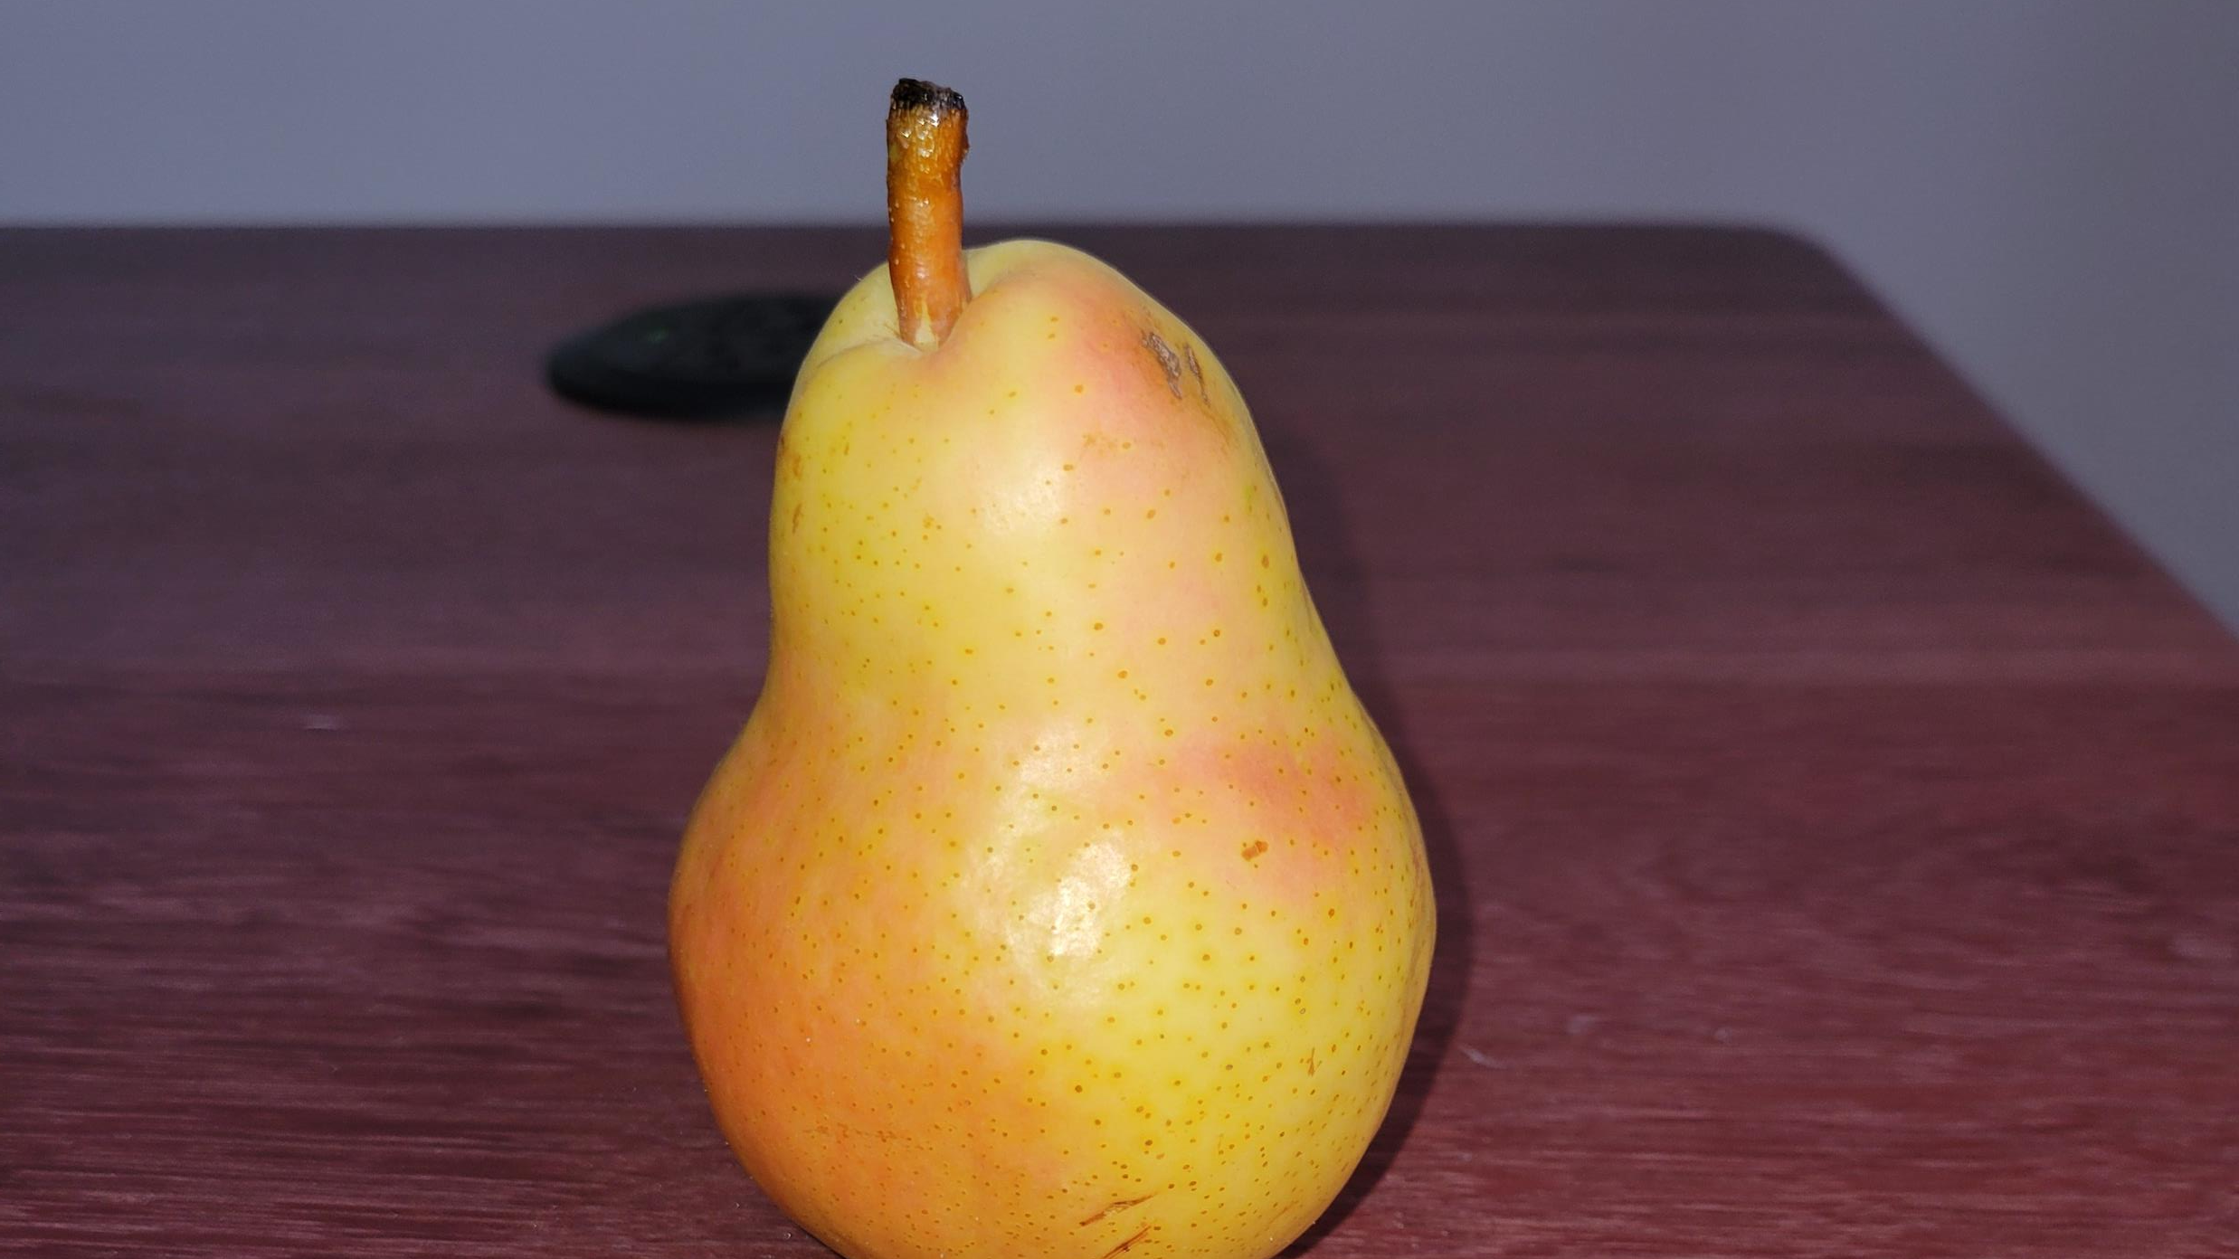
Interface & Inheritance
How to copy code cleanly

Slide 2
Interfaces
Example
public interface IPlant
{
List<Fruit> Fruits { get; set;}
void Harvest();
void Harvest(DateTime dateOfHarvest);
}
An interface is the definition of the outputs, inputs and properties of a class regardless of implementation.
You can view it as a black box where you were only given the how to interact with.
Usefulness :
Dependency injection
Decoupling of the code
Easier unit test
Notes:
Started with Interface as both interface and inheritance can be confused but are extremely different in both application and uses. And they can work hand-in-hand.
For the example, apple tree and pear tree could be 2 different implementation of the interface that doesn’t share the same exact logic.

Slide 3
Inheritance
Example
public class Plant
{
public List<Fruit> Fruits { get; set;}
public void Harvest()
{
Console.WriteLine(“Harvested”);
}
}
public class Pyrus : Plant
{
public int GetHeight()
{
return 10;
}
}
Inheritance enables you to create new classes that reuse, extend, and modify the behavior defined in other classes.
In other words, the parent class can define some logic and properties that a child class can reuse as it is, change if necessary, and/or even add to it.
Usefulness :
Reuse of code
Standardizing component logic while allowing for specialization
Notes:
Pyrus (Pear tree)

